Slide 1
COMP 2710 Software Construction
Inheritance
Dr. Alvin Lim
Auburn University
http://www.eng.auburn.edu/~lim
limalvi@auburn.edu
Fall 2014
Notes:
Inheritance Basics
Derived classes, with constructors
protected: qualifier
Redefining member functions
Non-inherited functions
Programming with Inheritance
Assignment operators and copy constructors
Destructors in derived classes
Multiple inheritance

Slide 2
Introduction to Inheritance
Object-oriented programming
  Powerful programming technique
  Provides abstraction dimension called inheritance
General form of class is defined
  Specialized versions then inherit properties of
  general class
  And add to it/modify it’s functionality for it’s
  appropriate use
Copyright © 2008 Pearson Addison-Wesley. All rights reserved.
14-<number>

Slide 3
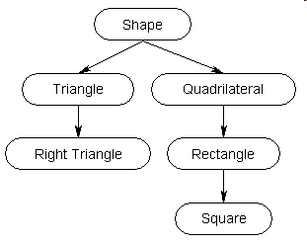
Inheritance – An Example
14-<number>

Slide 4
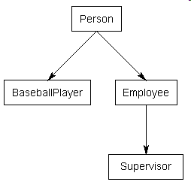
Inheritance – Another Example
BaseballPlayer, Employee, Person, Supervisor
What is the class diagram for these classes?
14-<number>

Slide 5
Inheritance Terminology
Common to simulate family relationships
Parent class
  Refers to base class
Child class
  Refers to derived class
Ancestor class
  Class that’s a parent of a parent …
Descendant class
  Opposite of ancestor
Copyright © 2008 Pearson Addison-Wesley. All rights reserved.
14-<number>

Slide 6
Inheritance Basics
New class inherited from another class
Base class
  "General" class from which others derive
Derived class
  New class
  Automatically has base class’s:
    Member variables
    Member functions
  Can then add additional member functions
  and variables
Copyright © 2008 Pearson Addison-Wesley. All rights reserved.
14-<number>

Slide 7
Derived Classes
Consider example:
Class of "Employees"
Composed of:
  Salaried employees
  Hourly employees
Each is "subset" of employees
  Another might be those paid fixed wage each
  month or week
Copyright © 2008 Pearson Addison-Wesley. All rights reserved.
14-<number>

Slide 8
Employee Class
Many members of "employee" class apply
to all types of employees
  Accessor functions
  Mutator functions
  Most data items:
    SSN
    Name
    Pay
We won’t have "objects" of this class, however
Copyright © 2008 Pearson Addison-Wesley. All rights reserved.
14-<number>

Slide 9
Employee Class
Consider printCheck() function:
  Will always be "redefined" in derived classes
  So different employee types can have
  different checks
  Makes no sense really for "undifferentiated"
  employee
  So function printCheck() in Employee class
  says just that
    Error message stating "printCheck called for
    undifferentiated employee!! Aborting…"
Copyright © 2008 Pearson Addison-Wesley. All rights reserved.
14-<number>

Slide 10
Deriving from Employee Class
Derived classes from Employee class:
  Automatically have all member variables
  Automatically have all member functions
Derived class said to "inherit" members
from base class
Can then redefine existing members
and/or add new members
Copyright © 2008 Pearson Addison-Wesley. All rights reserved.
14-<number>
Notes:
Demonstration: employee.h employee.cpp hourlyemployee.h hourlyemployee.cpp salariedemployee.h salariedemployee.cpp

Slide 11
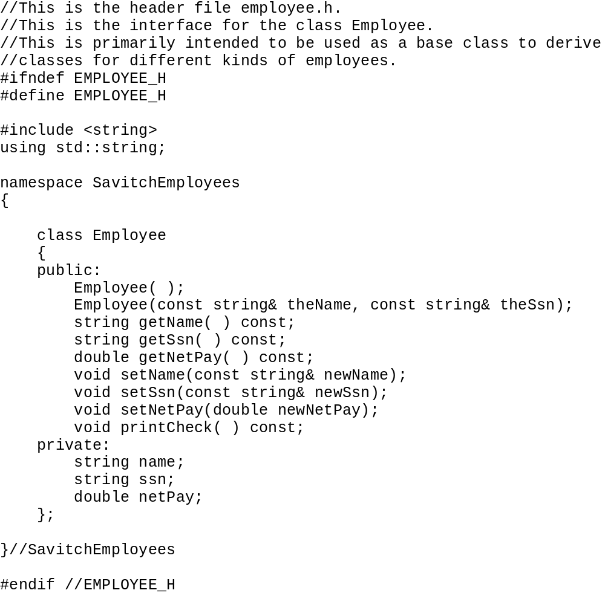
Copyright © 2008 Pearson Addison-Wesley. All rights reserved.
14-<number>

Slide 12
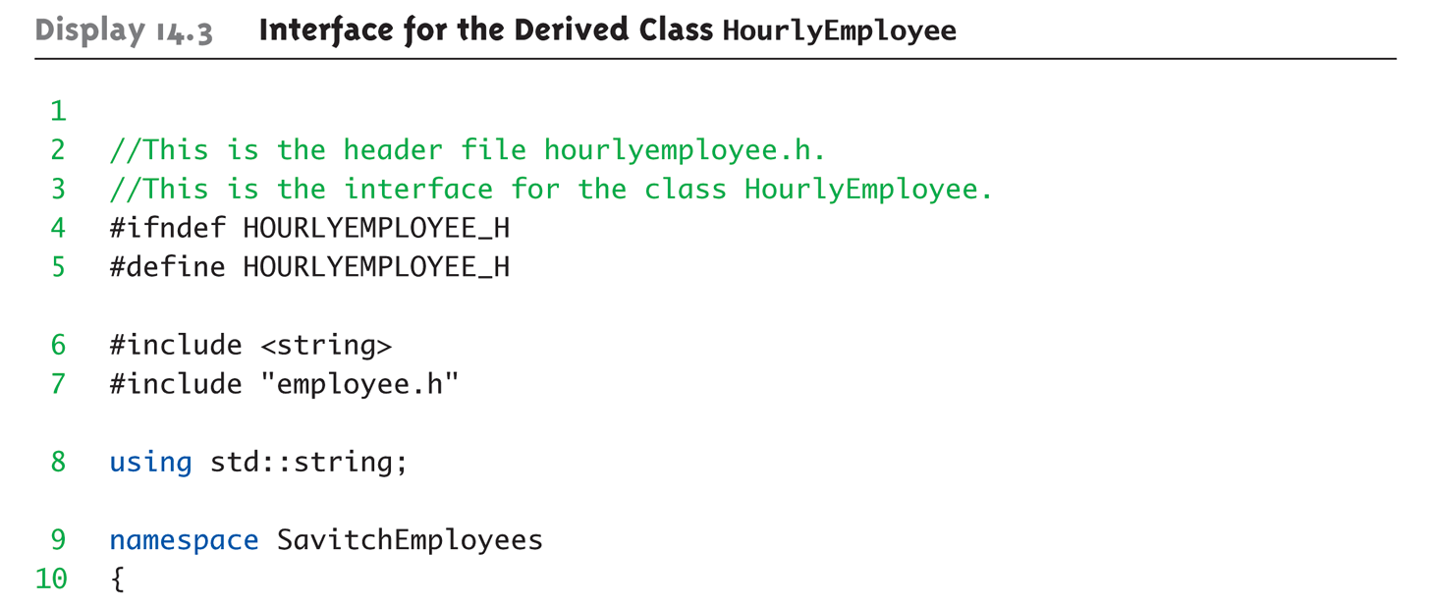
Display 14.3 Interface for the Derived Class HourlyEmployee (1 of 2)
Copyright © 2008 Pearson Addison-Wesley. All rights reserved.
14-<number>

Slide 13
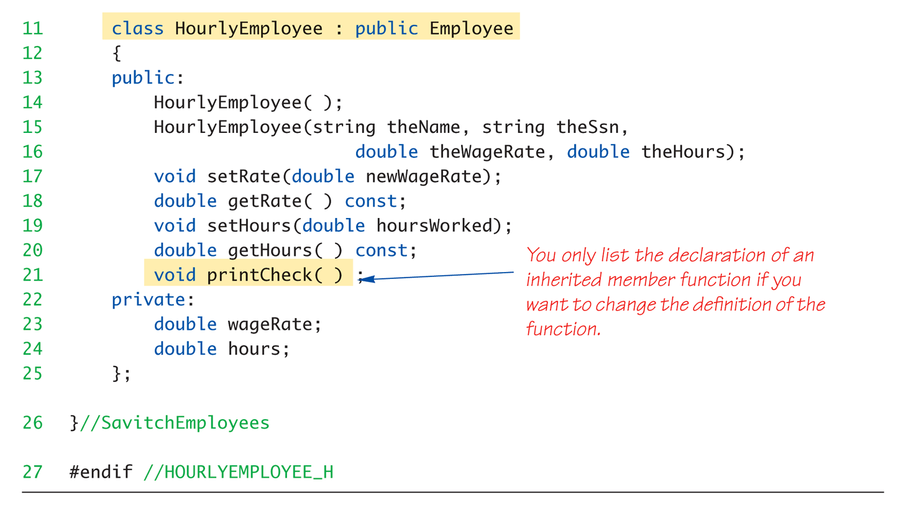
Display 14.3 Interface for the Derived Class HourlyEmployee (2 of 2)
Copyright © 2008 Pearson Addison-Wesley. All rights reserved.
14-<number>

Slide 14
HourlyEmployee Class Interface
Note definition begins same as any other
  #ifndef structure
  Includes required libraries
  Also includes employee.h!
And, the heading:
class HourlyEmployee : public Employee
{ …
  Specifies "publicly inherited" from Employee
  class
Copyright © 2008 Pearson Addison-Wesley. All rights reserved.
14-<number>

Slide 15
HourlyEmployee Class Additions
Derived class interface only lists new or
"to be redefined" members
  Since all others inherited are already defined
  i.e.: "all" employees have ssn, name, etc.
HourlyEmployee adds:
  Constructors
  wageRate, hours member variables
  setRate(), getRate(), setHours(), getHours()
  member functions
Copyright © 2008 Pearson Addison-Wesley. All rights reserved.
14-<number>

Slide 16
HourlyEmployee Class Redefinitions
HourlyEmployee redefines:
  printCheck() member function
  This "overrides" the printCheck() function
  implementation from Employee class
It’s definition must be in HourlyEmployee
class’s implementation
  As do other member functions declared in
  HourlyEmployee’s interface
    New and "to be redefined"
Copyright © 2008 Pearson Addison-Wesley. All rights reserved.
14-<number>

Slide 17
Constructors in Derived Classes
Base class constructors are NOT inherited in derived classes!
  But they can be invoked within derived class
  constructor
    Which is all we need!
Base class constructor must initialize all
base class member variables
  Those inherited by derived class
  So derived class constructor simply calls it
    "First" thing derived class constructor does
Copyright © 2008 Pearson Addison-Wesley. All rights reserved.
14-<number>

Slide 18
Derived Class Constructor Example
Consider syntax for HourlyEmployee
constructor:
HourlyEmployee::HourlyEmployee(string theName,
string theNumber, double theWageRate,
double theHours)
: Employee(theName, theNumber),
wageRate(theWageRate), hours(theHours)
{
//Deliberately empty
}
Portion after : is "initialization section"
  Includes invocation of Employee constructor
Copyright © 2008 Pearson Addison-Wesley. All rights reserved.
14-<number>

Slide 19
Another HourlyEmployee Constructor
A second constructor:
HourlyEmployee::HourlyEmployee()
: Employee(), wageRate(0), hours(0)
{
//Deliberately empty
}
Default version of base class constructor
is called (no arguments)
Should always invoke one of the base
class’s constructors
Copyright © 2008 Pearson Addison-Wesley. All rights reserved.
14-<number>

Slide 20
Constructor: No Base Class Call
Derived class constructor should always
invoke one of the base class’s constructors
If you do not:
  Default base class constructor automatically called
Equivalent constructor definition:
HourlyEmployee::HourlyEmployee()
: wageRate(0), hours(0)
{ }
Copyright © 2008 Pearson Addison-Wesley. All rights reserved.
14-<number>

Slide 21
Pitfall: Base Class Private Data
Derived class "inherits" private member
variables
  But still cannot directly access them
  Not even through derived class member
  functions!
Private member variables can ONLY be
accessed "by name" in member functions of the class they’re defined in
HourlyEmployee john(“John”, “123456789”, 0, 0);
john.setName(“My-John”);
Copyright © 2008 Pearson Addison-Wesley. All rights reserved.
14-<number>

Slide 22
Pitfall: Base Class Private Member Functions
Same holds for base class
private member functions
  Cannot be accessed outside interface and
  implementation of base class
  Not even in derived class member
  function definitions
Copyright © 2008 Pearson Addison-Wesley. All rights reserved.
14-<number>

Slide 23
Pitfall: Base Class Private Member Functions Impact
Larger impact here vs. member variables
  Private member variables can be accessed indirectly
  via accessor or mutator member functions
  Private member functions simply not available
This is "reasonable"
  Private member functions should be simply
  "helper" functions
  Should be used only in class they’re defined
Copyright © 2008 Pearson Addison-Wesley. All rights reserved.
14-<number>

Slide 24
The protected: Qualifier
New classification of class members
Allows access "by name" in derived class
  But nowhere else
  Still no access "by name" in other classes
In class it’s defined → acts like private
Considered "protected" in derived class
  To allow future derivations
Many feel this "violates" information hiding
Copyright © 2008 Pearson Addison-Wesley. All rights reserved.
14-<number>

Slide 25
Redefinition of Member Functions
Recall interface of derived class:
  Contains declarations for new member functions
  Also contains declarations for inherited
  member functions to be changed
  Inherited member functions NOT declared:
    Automatically inherited unchanged
Implementation of derived class will:
  Define new member functions
  Redefine inherited functions as declared
Copyright © 2008 Pearson Addison-Wesley. All rights reserved.
14-<number>

Slide 26
Redefining vs. Overloading
Very different!
Redefining in derived class:
  SAME parameter list
  Essentially "re-writes" same function
Overloading:
  Different parameter list
  Defined "new" function that takes
  different parameters
  Overloaded functions must have
  different signatures
Copyright © 2008 Pearson Addison-Wesley. All rights reserved.
14-<number>

Slide 27
A Function’s Signature
Recall definition of a "signature":
  Function’s name
  Sequence of types in parameter list
    Including order, number, types
Signature does NOT include:
  Return type
  const keyword
  &
Copyright © 2008 Pearson Addison-Wesley. All rights reserved.
14-<number>

Slide 28
Accessing Redefined Base Function
When redefined in derived class, base
class’s definition not "lost"
Can specify it’s use:
Employee JaneE;
HourlyEmployee SallyH;
JaneE.printCheck(); → calls Employee’s
printCheck function
SallyH.printCheck(); → calls HourlyEmployee
printCheck function
SallyH.Employee::printCheck(); → Calls Employee’s
printCheck function!
Not typical here, but useful sometimes
Copyright © 2008 Pearson Addison-Wesley. All rights reserved.
14-<number>

Slide 29
Functions Not Inherited
All "normal" functions in base class are
inherited in derived class
Exceptions:
  Constructors (we’ve seen)
  Destructors
  Copy constructor
    But if not defined, generates "default" one
    Recall need to define one for pointers!
  Assignment operator
    If not defined → default
Copyright © 2008 Pearson Addison-Wesley. All rights reserved.
14-<number>

Slide 30
Assignment Operators and Copy Constructors
Recall: overloaded assignment operators and copy constructors
NOT inherited
  But can be used in derived class definitions
  Typically MUST be used!
  Similar to how derived class constructor
  invokes base class constructor
Copyright © 2008 Pearson Addison-Wesley. All rights reserved.
14-<number>

Slide 31
Assignment Operator Example
Given "Derived" is derived from "Base":
Derived& Derived::operator =(const Derived & rightSide)
{
Base::operator =(rightSide);
…
}
Notice code line
  Calls assignment operator from base class
    This takes care of all inherited member variables
  Would then set new variables from derived
  class…
Copyright © 2008 Pearson Addison-Wesley. All rights reserved.
14-<number>

Slide 32
Copy Constructor Example
Consider:
Derived::Derived(const Derived& Object)
: Base(Object), …
{…}
After : is invocation of base copy constructor
  Sets inherited member variables of derived
  class object being created
  Note Object is of type Derived; but it’s also of
  type Base, so argument is valid
Copyright © 2008 Pearson Addison-Wesley. All rights reserved.
14-<number>

Slide 33
Destructors in Derived Classes
If base class destructor functions correctly
  Easy to write derived class destructor
When derived class destructor is invoked:
  Automatically calls base class destructor!
  So no need for explicit call
So derived class destructors need only be
concerned with derived class variables
  And any data they "point" to
  Base class destructor handles inherited data
  automatically
Copyright © 2008 Pearson Addison-Wesley. All rights reserved.
14-<number>

Slide 34
Destructor Calling Order
Consider:
class B derives from class A
class C derives from class B
A ← B ← C
When object of class C goes out of scope:
  Class C destructor called 1st
  Then class B destructor called
  Finally class A destructor is called
Opposite of how constructors are called
Copyright © 2008 Pearson Addison-Wesley. All rights reserved.
14-<number>

Slide 35
"Is a" vs. "Has a" Relationships
Inheritance
  Considered an "Is a" class relationship
  e.g., An HourlyEmployee "is a" Employee
  A Convertible "is a" Automobile
A class contains objects of another class
as it’s member data
  Considered a "Has a" class relationship
  e.g., One class "has a" object of another
  class as it’s data
Copyright © 2008 Pearson Addison-Wesley. All rights reserved.
14-<number>

Slide 36
Protected and Private Inheritance
New inheritance "forms"
  Both are rarely used
Protected inheritance:
class SalariedEmployee : protected Employee
{…}
  Public members in base class become
  protected in derived class
Private inheritance:
class SalariedEmployee : private Employee
{…}
  All members in base class become private
  in derived class
Copyright © 2008 Pearson Addison-Wesley. All rights reserved.
14-<number>

Slide 37
Multiple Inheritance
Derived class can have more than one
base class!
  Syntax just includes all base classes
  separated by commas:
  class derivedMulti : public base1, base2
  {…}
Possibilities for ambiguity are endless!
Dangerous undertaking!
  Some believe should never be used
  Certainly should only be used by experienced
  programmers!
Copyright © 2008 Pearson Addison-Wesley. All rights reserved.
14-<number>

Slide 38
Summary 1
Inheritance provides code reuse
  Allows one class to "derive" from another,
  adding features
Derived class objects inherit members of
base class
  And may add members
Private member variables in base class
cannot be accessed "by name" in derived
Private member functions are not inherited
Copyright © 2008 Pearson Addison-Wesley. All rights reserved.
14-<number>

Slide 39
Summary 2
Can redefine inherited member functions
  To perform differently in derived class
Protected members in base class:
  Can be accessed "by name" in derived class
  member functions
Overloaded assignment operator not inherited
  But can be invoked from derived class
Constructors are not inherited
  Are invoked from derived class’s constructor
Copyright © 2008 Pearson Addison-Wesley. All rights reserved.
14-<number>

